Slide 1

Predicting Vaccine Status
Gabi Rivera
University of San Diego
Shiley-Marcos School of Engineering
22 Oct 2022

Slide 2
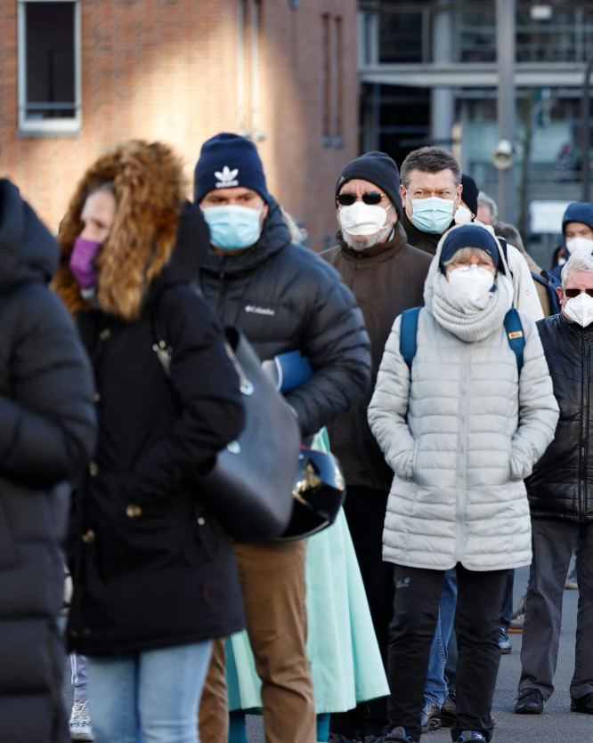
Predicting Vaccine Status
Pandemic
Rise of COVID-19 virus
No available vaccine (still in clinical trial)
Challenge to quickly accomplish herd immunity
National 2009 H1N1 Flu Survey (NHFS)
H1N1 vaccine survey dataset
Seasonal vaccine survey dataset
Associated background profile (i.e., sex, race, education, income, region), personal health opinions, and health behaviors
Morris Mac Matzen / AFP via Getty Images fil

Slide 3

H1N1 Vs COVID-19 Predictive Model
H1N1 virus vs COVID-19 virus
Both respiratory illnesses
In first 12 months worldwide:
H1N1 virus = 284,000 deaths
COVID-19 virus = 2 M deaths
HIPAA and Patient Authorization Consent
NHSF participants
COVID-19 virus survey participants(once vaccine is available)

Slide 4
Vaccination Status Predictive Model
Multinomial Logistic (SoftMax) Regression Model
Allow 20-30% error between dataset
K-S statistical score of 70% precision and accuracy against the training dataset
Repeatability testing: allow 20% difference
The goal of the predictive model and maintenance
Predict the likelihood of vaccination
Prevent uneven access to vaccination
Decrease vaccine hesitancy and misinformation
Decrease COVID-19 reinfection within 6 months
Decrease transmission rate

Slide 5
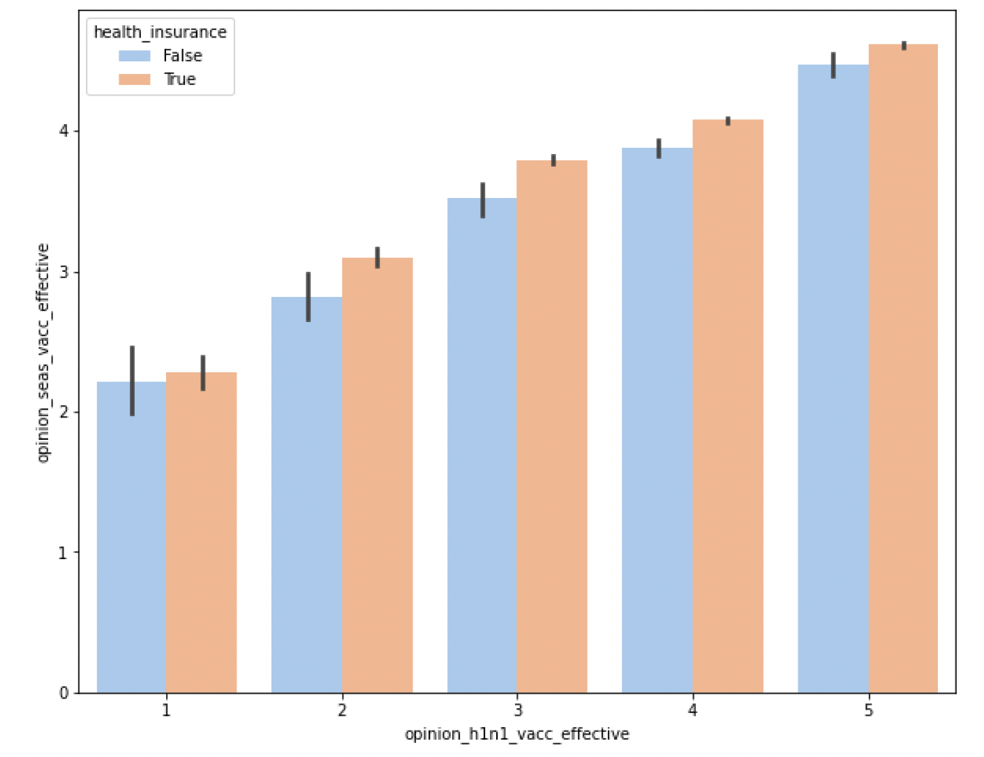
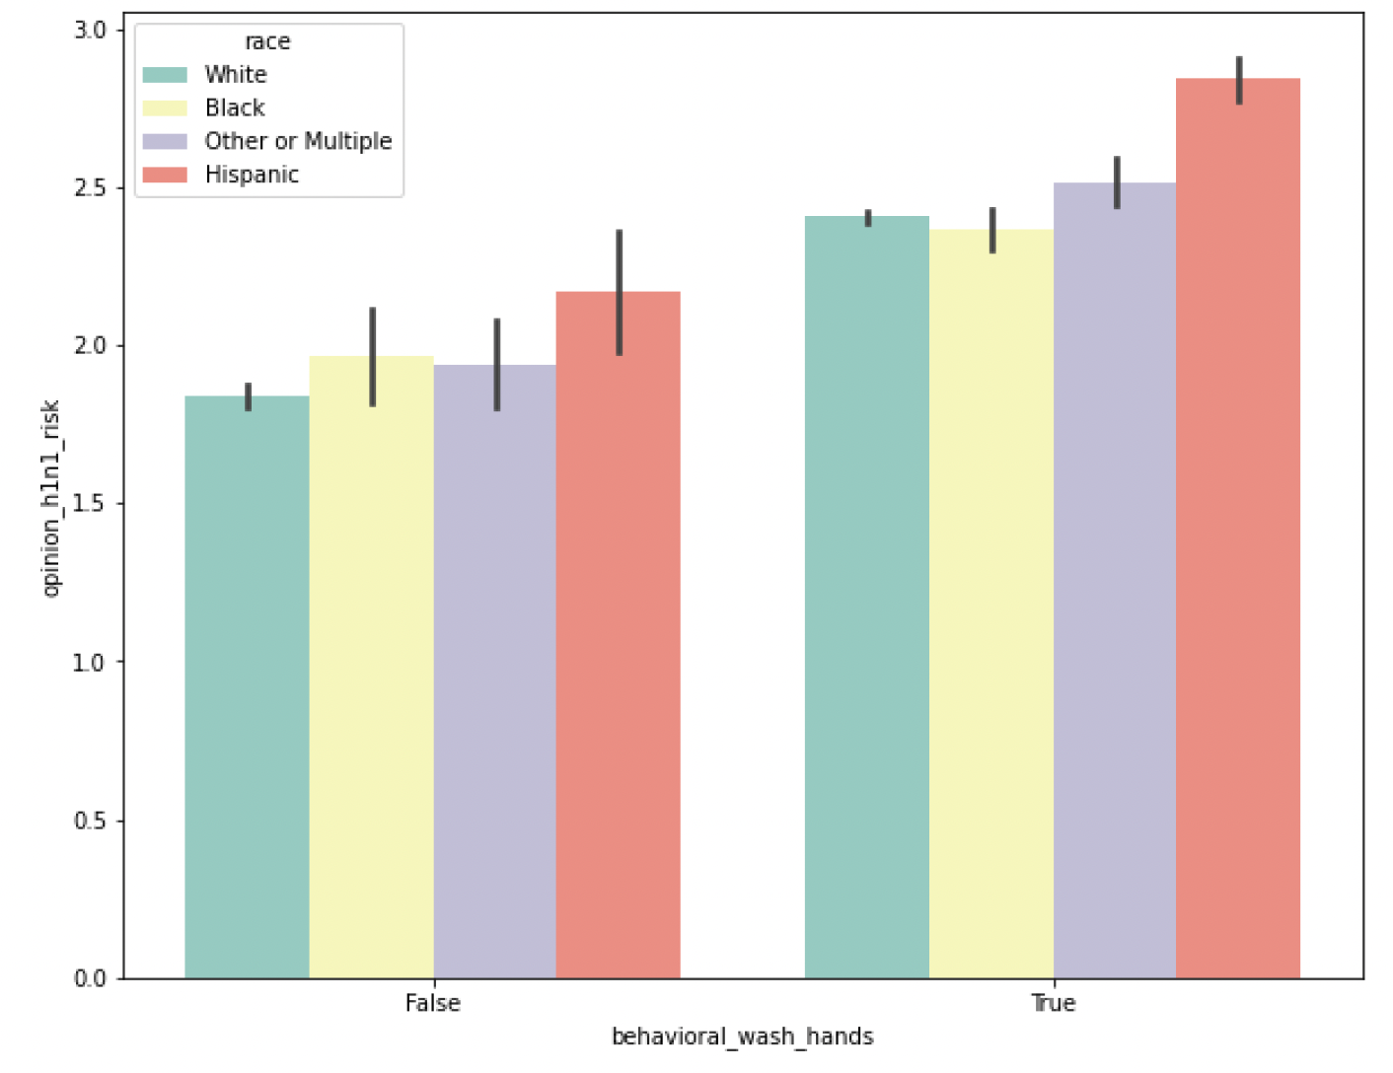
Exploratory Data Analysis
Opinions on the effectiveness of H1N1 vs Seasonal Vaccine with having health insurance
Hand washing vs opinions on the risk of H1N1 by race

Slide 6
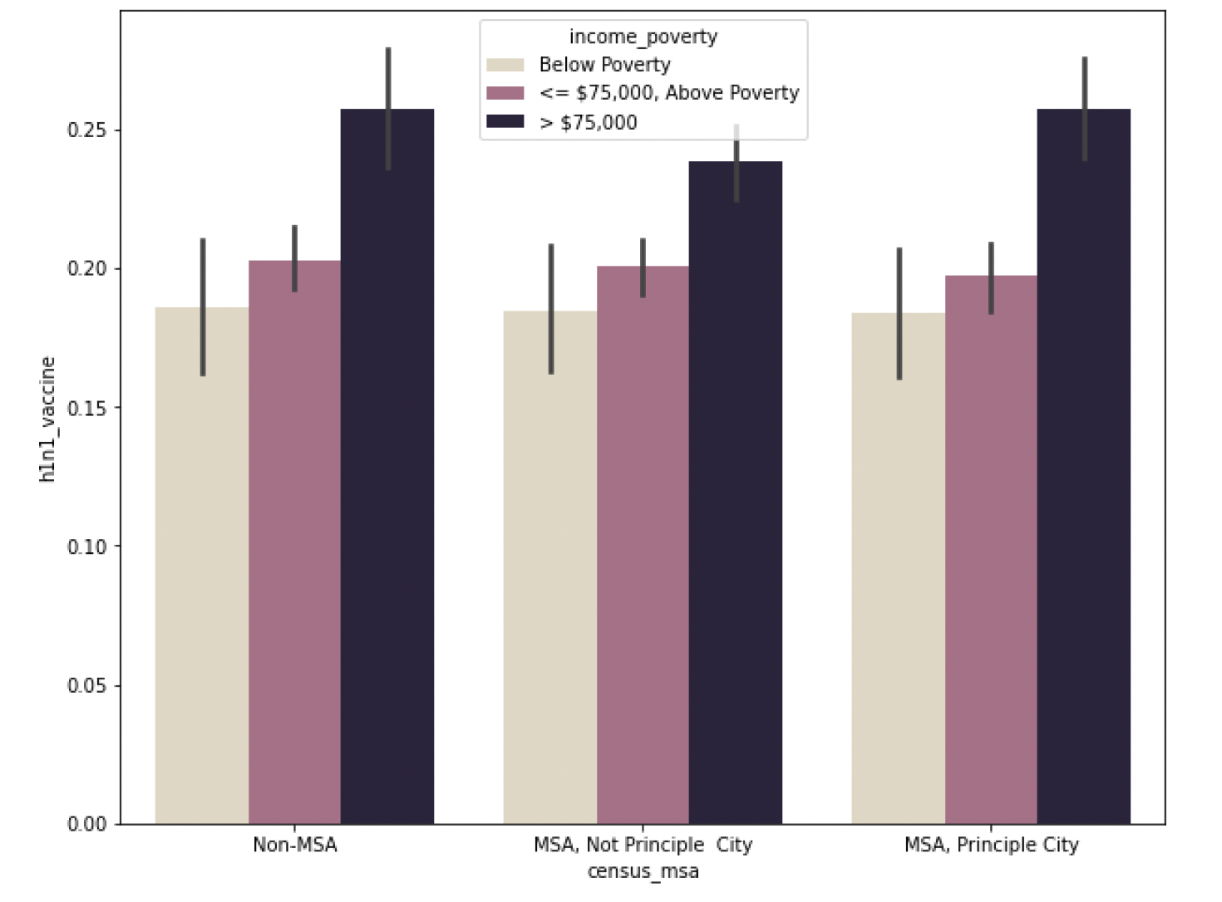
Exploratory Data Analysis
Population density vs H1N1 vaccination by poverty thresholds

Slide 7

Next Steps
Business Alignment
Additional requirements and goals
data security, privacy, and legal restrictions
Data Mining Process
Phase I = H1N1 model creation
Phase II = COVID-19 integration
Maintenance and repeatability

Slide 8
References:
Centers for Disease Control and Prevention. (2022, August 16). CDC Museum Covid-19 Timeline. Centers for Disease Control and Prevention. Retrieved October 3, 2022, from https://www.cdc.gov/museum/timeline/covid19.html
Centers for Disease Control and Prevention. (2022, January 18). Similarities and differences between flu and covid-19​. Centers for Disease Control and Prevention. Retrieved September 11, 2022, from https://www.cdc.gov/flu/symptoms/flu-vs-covid19.htm
Centers for Disease Control and Prevention. (2020, July 30). Immunization and respiratory diseases (NCIRD) overview. Centers for Disease Control and Prevention. Retrieved September 11, 2022, from https://www.cdc.gov/ncird/overview/index.html
da Costa, V. G., Saivish, M. V., Santos, D. E., de Lima Silva, R. F., &amp; Moreli, M. L. (2020). Comparative epidemiology between the 2009 H1N1 influenza and COVID-19 pandemics. Journal of Infection and Public Health, 13(12), 1797–1804. https://doi.org/10.1016/j.jiph.2020.09.023
DrivenData. (n.d.). Flu shot learning: Predict H1N1 and seasonal flu vaccines. DrivenData. Retrieved September 11, 2022, from
https://www.drivendata.org/competitions/66/flu-shot-learning/page/211/
Seladi-Schulman, J. (2021, April 16). H1N1 influenza vs. COVID-19 comparison: Similarities &amp; Differences. Healthline. Retrieved October 2, 2022, from https://www.healthline.com/health/h1n1-vs-covid-19#quick-comparison-table
Shah, C. (2020). A hands-on introduction to Data Science. Cambridge University Press.

